Slide 1
CAREER TECHNICAL EDUCATION (CTE)
Character Leadership Attitude Scholarship Service

Slide 3
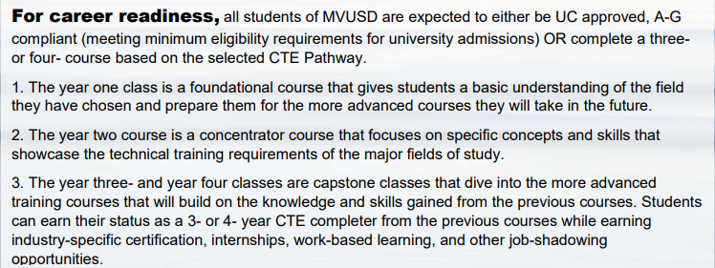

Slide 4
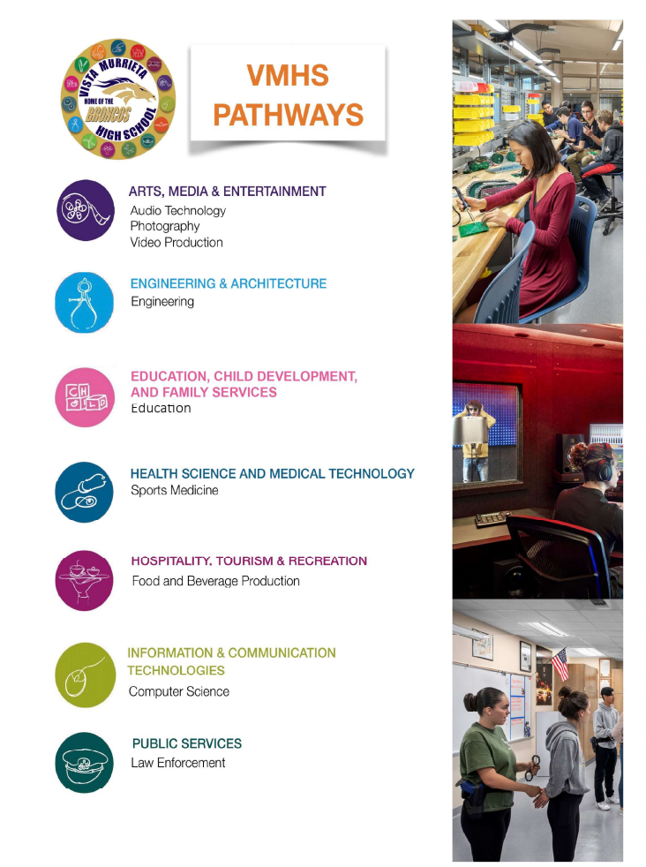
VMHS
Pathways
CAREER TECHNICAL EDUCATION (CTE)
VMHS-CTE website https://www.murrieta.k12.ca.us/Domain/1838

Slide 5
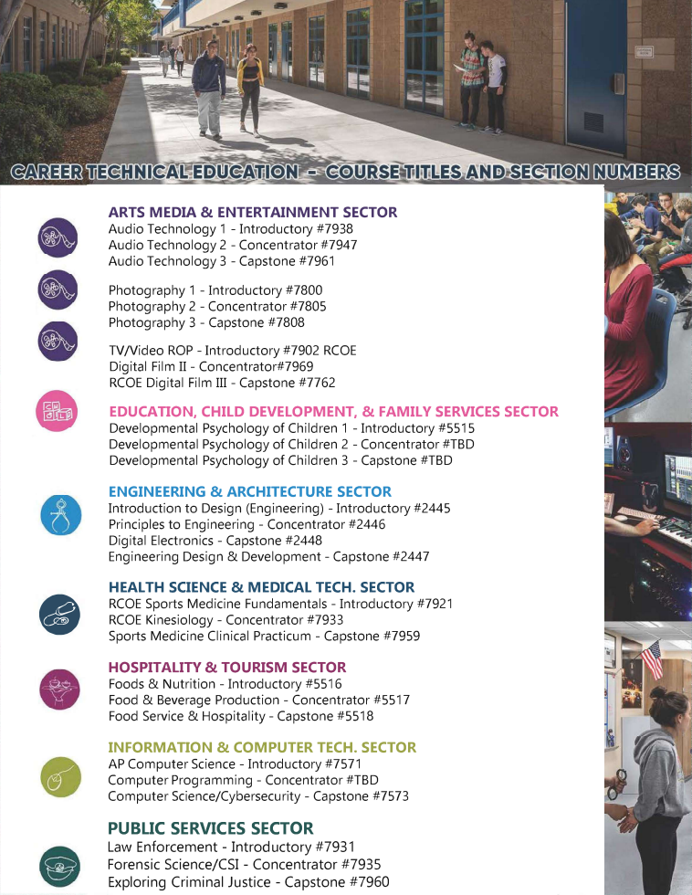

Slide 7
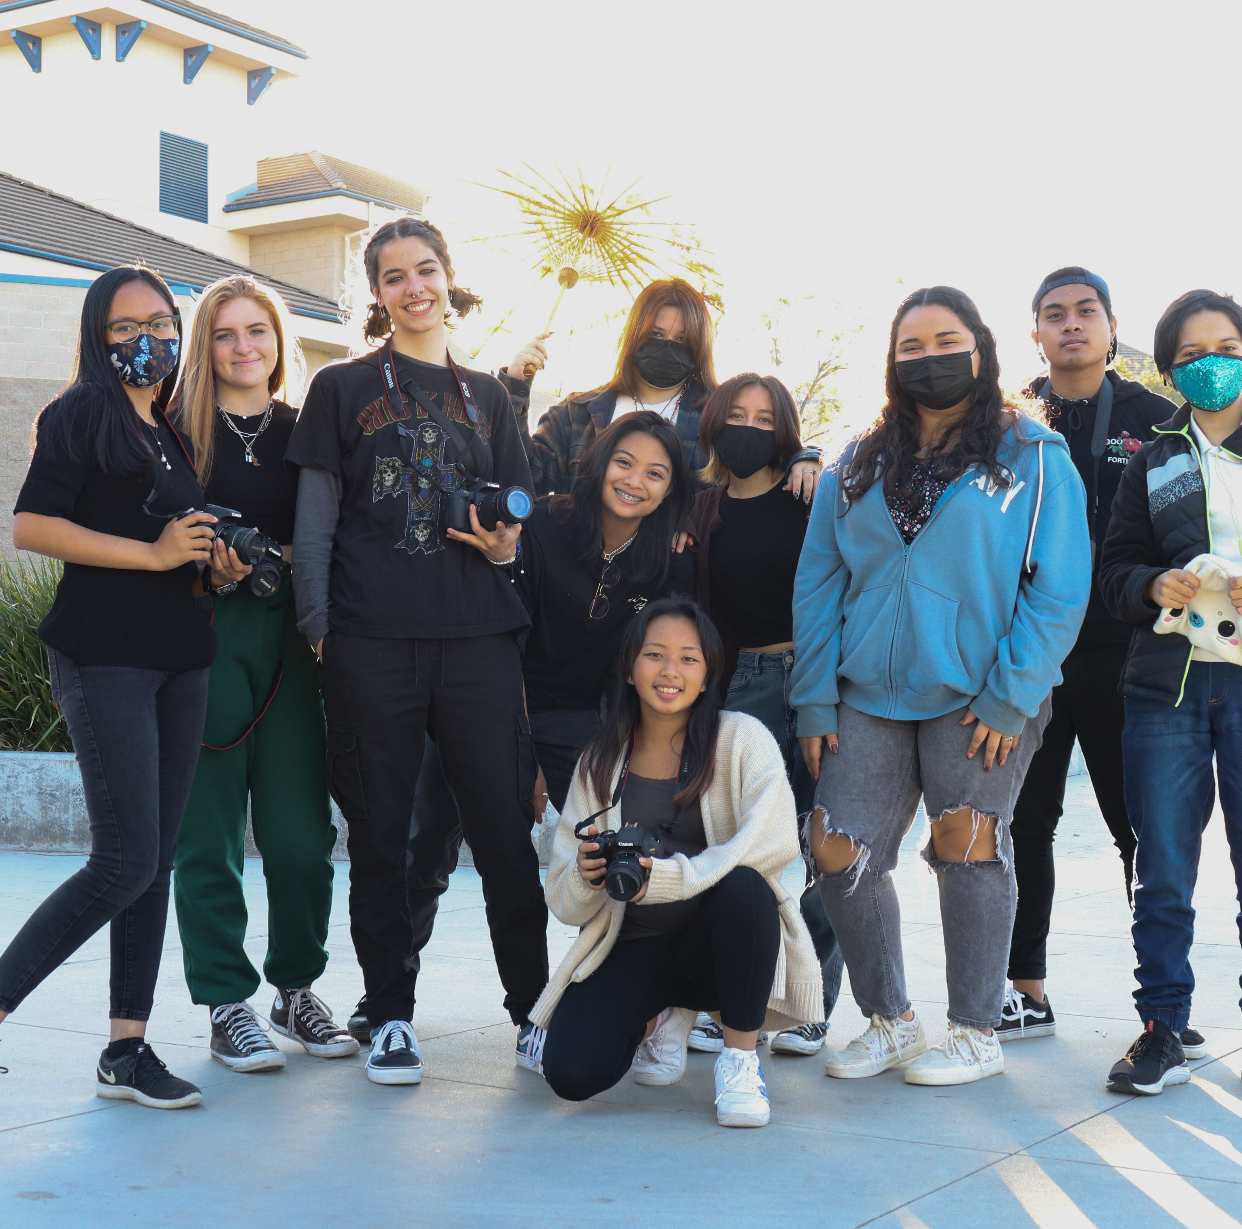
CTE ARTS MEDIA & ENTERTAINMENT SECTOR AUDIO TECHNOLOGY PHOTOGRAPHY DIGITAL FILM
Insert 3 photos - polaroid

Slide 8
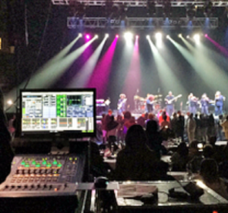
VMHS AUDIO TECHNOLOGY
Se
Two (2) “TA Periods”
[one (1) in Year 3 and one (1) in Year 4] are not required for pathway completion, nor are they required to be taken with the Digital Film Production Instructor (although both are highly encouraged).
Each course offered is articulated for college credit at Riverside Community College. This allows a student to receive up to seven (7) units of transferrable college credit.

Slide 9
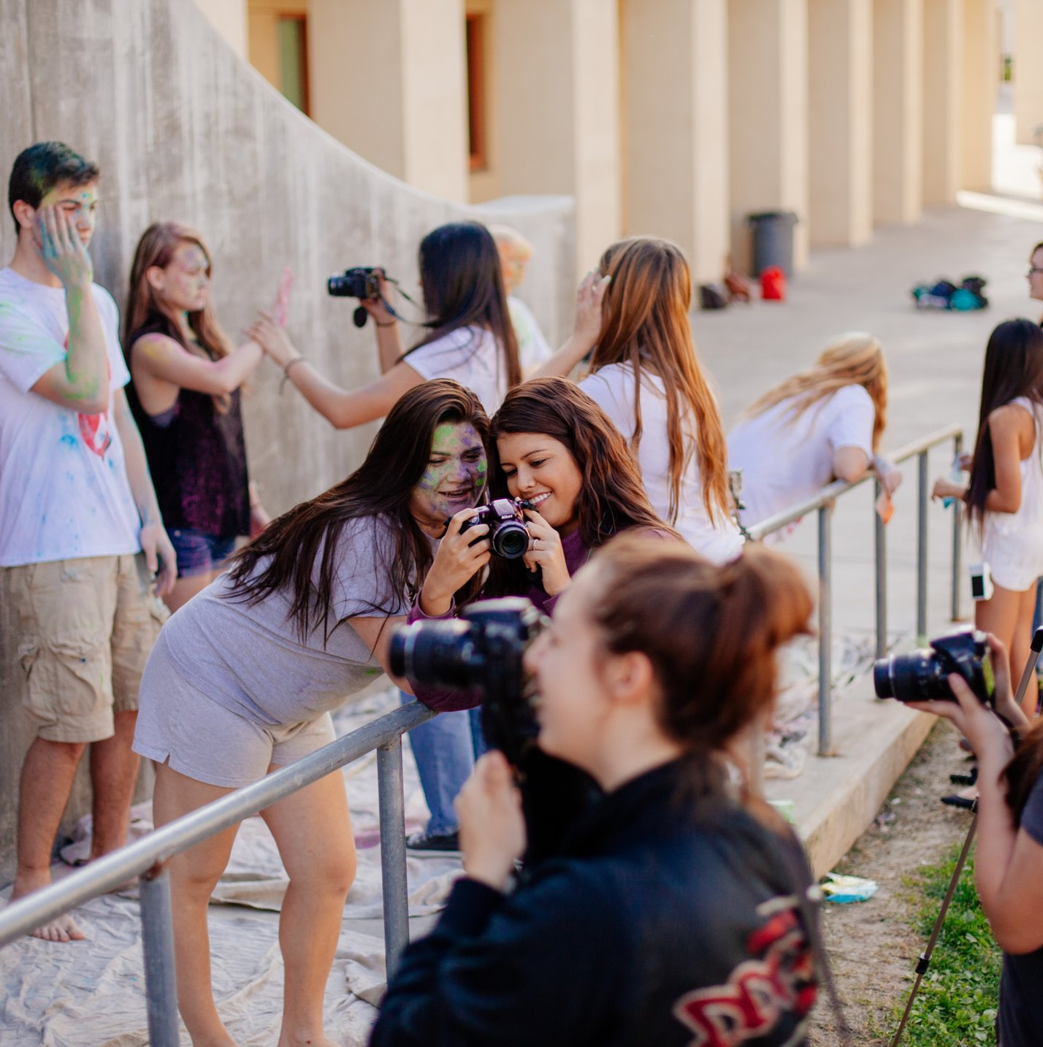
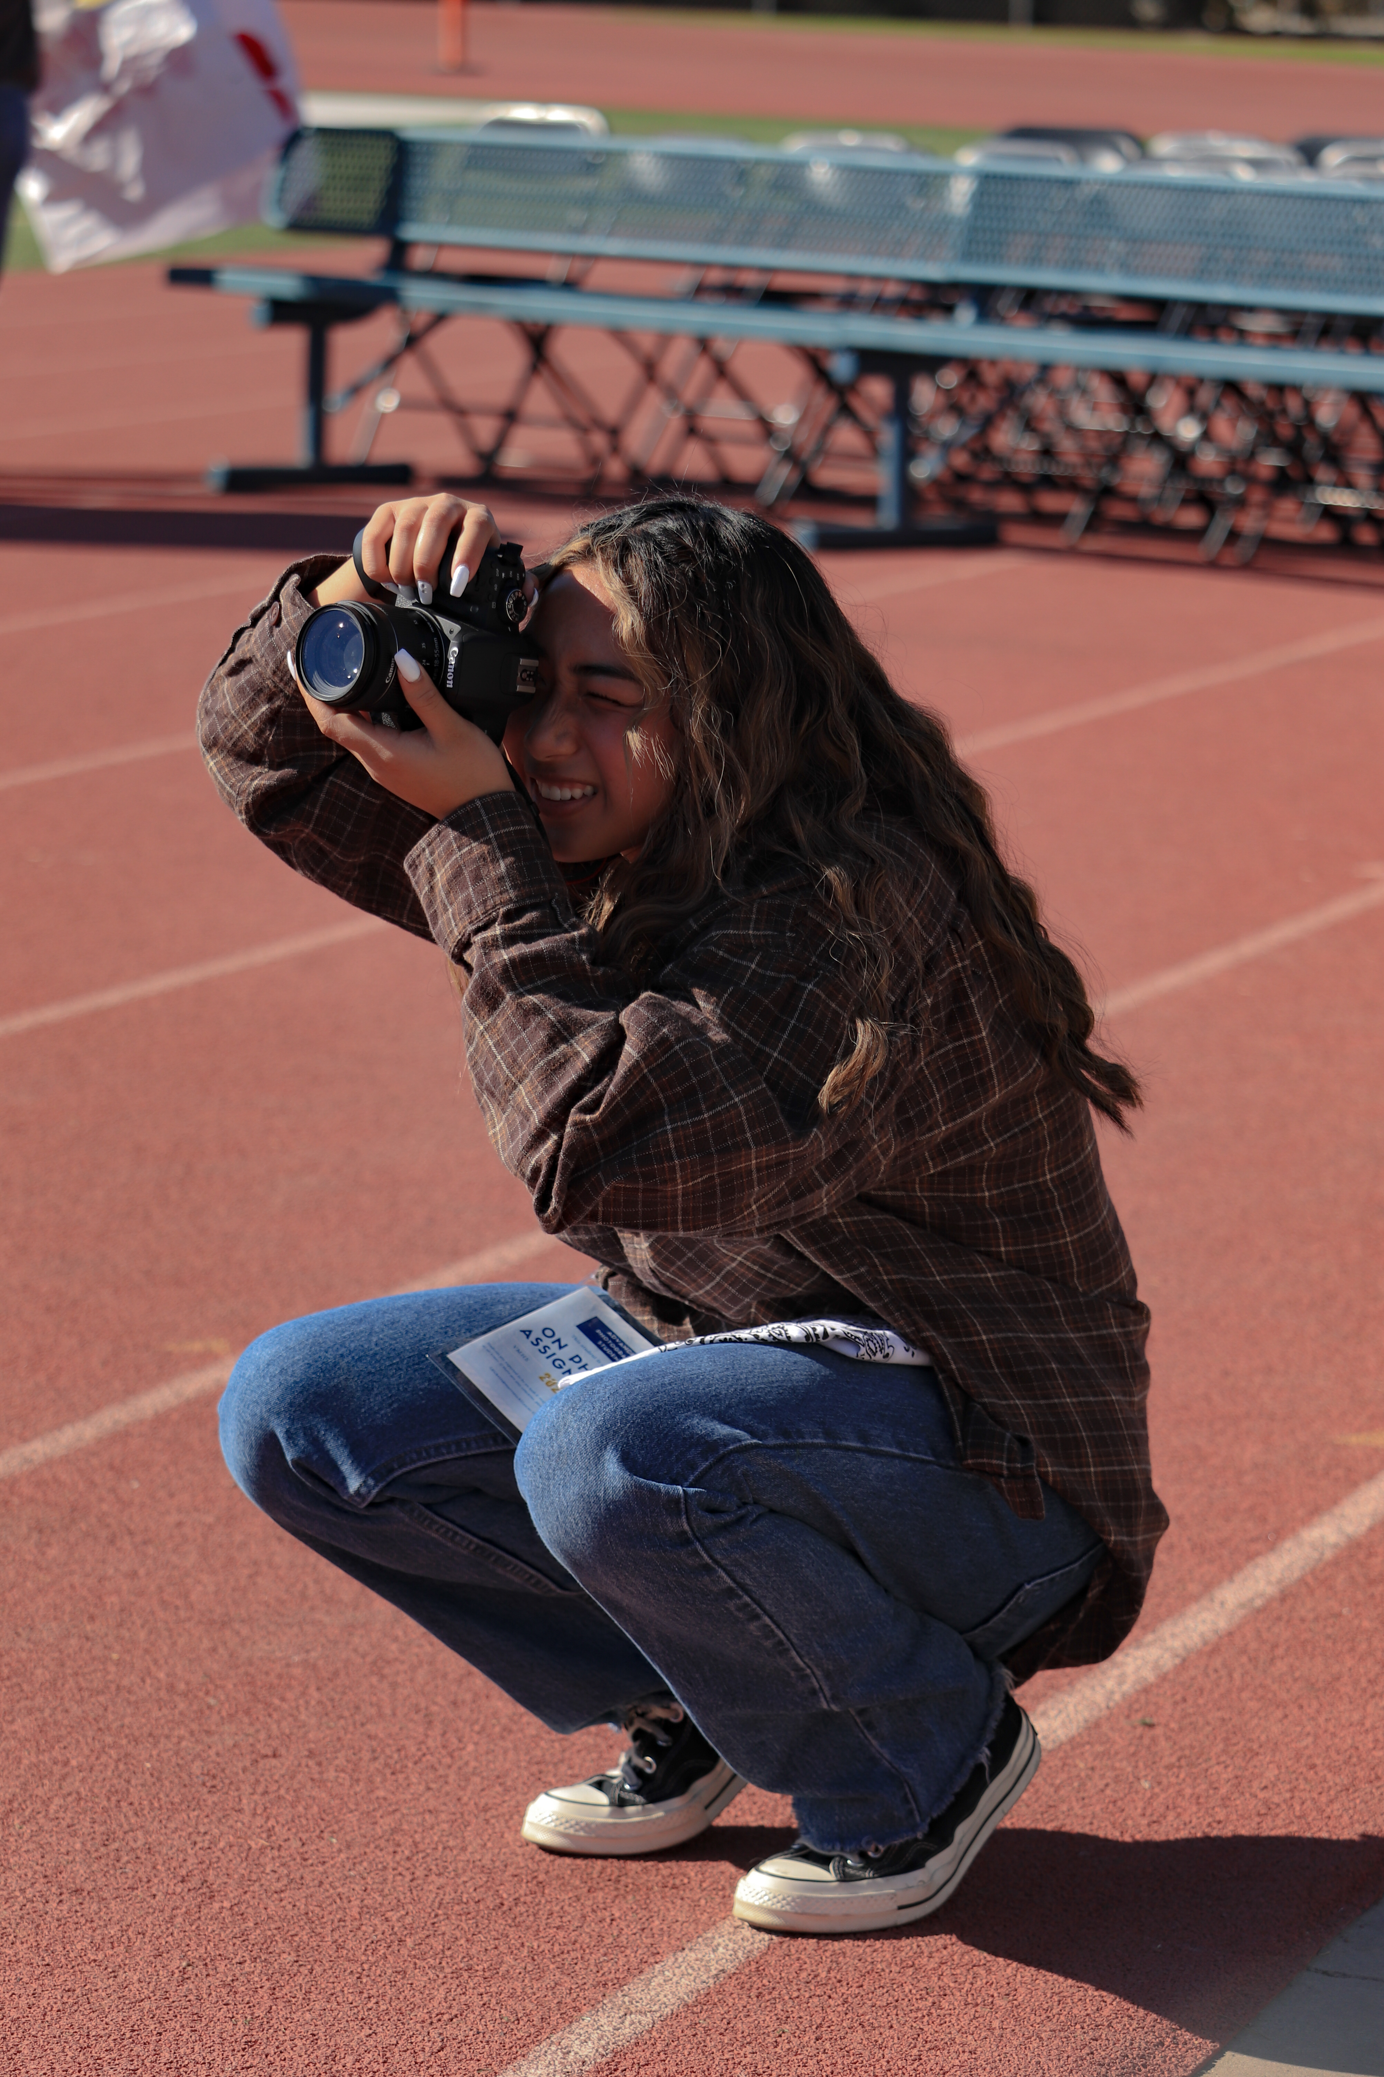
PHOTOGRAPHY
YEAR 1
Photography 1
An introductory course is the 1st class in the pathway and meets the UC/CSU "F" Requirement. This course covers:
Visual Composition & Storytelling
Art critique
Photoshop
Elements of Art/Design
History & Careers
Course #7800
YEAR 2
Photography 2
The concentrator course allows students to build on their previous skills and is articulated with MSJC. This course covers:
Studio Lighting
DSLR cameras/Exposure Triangle
Lightroom & Bridge
Beginning business, branding, and marketing skills
Online Portfolios
Competition submission
Course #7805
YEAR 3
Photography 3
Capstone course where students work as Student Photographers for Bronco Events and Culture. This course includes:
Photographing, editing, and delivering images for clubs, special projects, and Bronco Events
Advanced editing techniques
Advanced Studio Lighting
Access to all Advanced Level Equipment
Ongoing Photo Essays & Personal Projects
Career and College Preparation
Course #7808
Ms. Ricketts
Photography/CTE Teacher
Photographer/Business Owner
(951) 894-5750 ex. 6520
LRicketts@murrieta.k12.ca.us

Slide 10
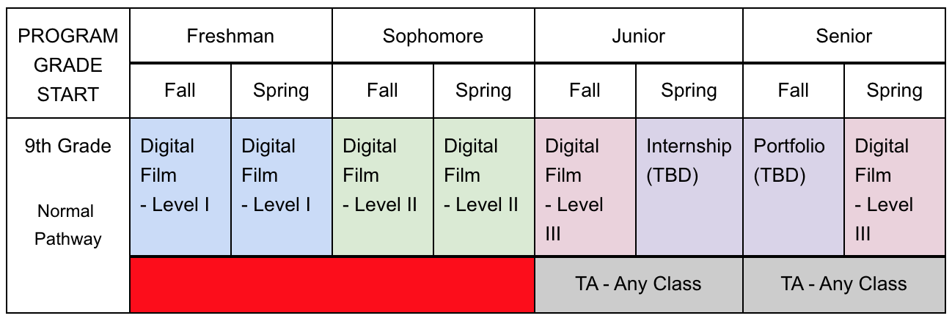
VMHS DIGITAL FILM PRODUCTION
Sophomores, Juniors, and Seniors made all films in this presentation!
Incoming freshmen students have the best pathway option available. This option allows a student to take four (4) separate and distinct course offerings in the Digital Film Production Pathway with Digital Film Production - Level III being the capstone course.
Senior year, students will
spend first (1st) semester putting together portfolio pieces to shop around to prospective employers OR
the student will utilize their portfolio in applying for colleges, universities, and/or collegiate scholarships.
Two (2) “TA Periods”
[one (1) in Year 3 and one (1) in Year 4] are not required for pathway completion, nor are they required to be taken with the Digital Film Production Instructor (although both are highly encouraged).
Each course offered is articulated for college credit at Riverside Community College. This allows a student to receive up to seven (7) units of transferrable college credit.

Slide 11
CONTACT INFORMATION
ADVISOR(S) CONTACT INFORMATION
Michael Ruiz
www.vmhs.net
Jake Rose
Audio Technology Instructor
Digital Film Video Instructor
www.vmhs.net
Vmhs.net
(951) 894-5750 ext. 6639
jhrose@murrieta.k12.ca.us
(951) 894-5750 ex. 6627
mruiz@murrieta.k12.ca.us

Slide 12
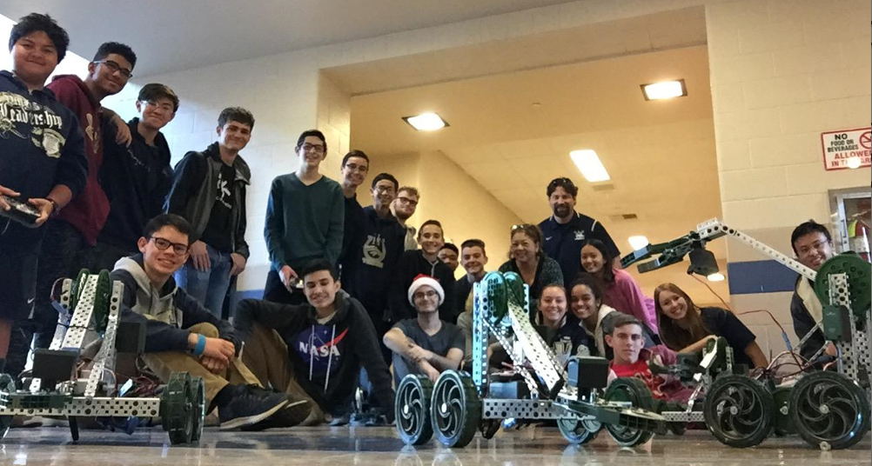
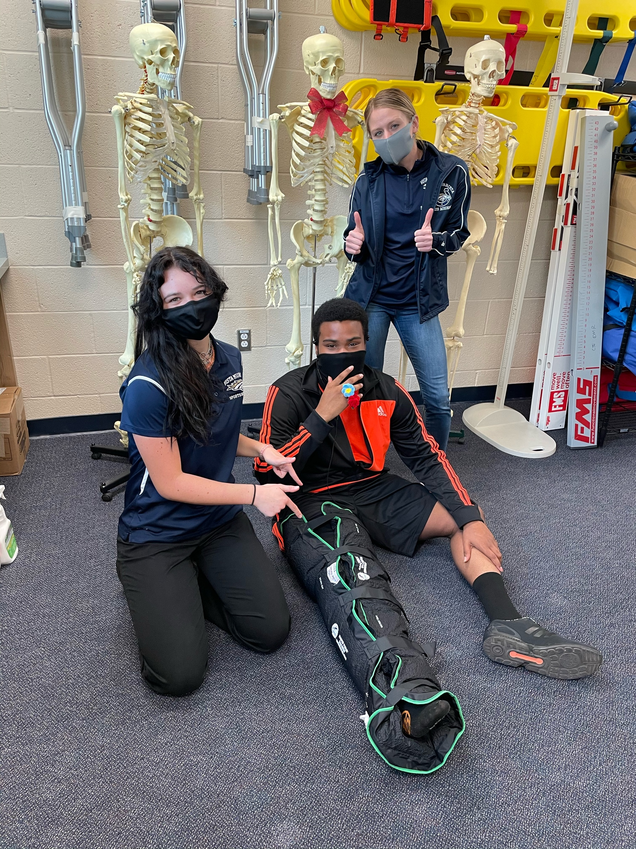
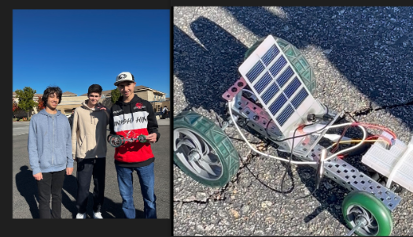
ENGINEERING & ARCHITECTURE SECTOR ENGINEERING INFORMATION & COMMUNICATION TECHNOLOGY SECTOR COMPUTER SCIENCE HEALTH SCIENCE & MEDICAL TECHNOLOGY SECTOR SPORTS MEDICINE
Insert 3 photos - polaroid

Slide 13
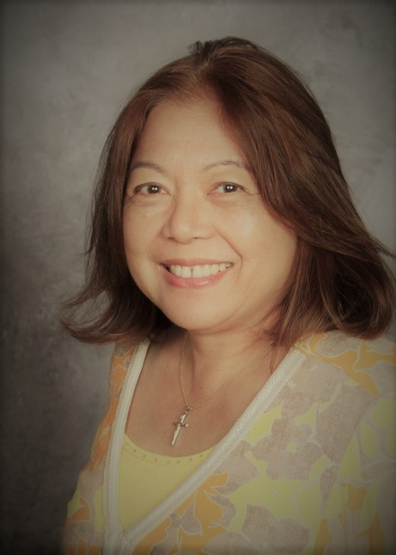
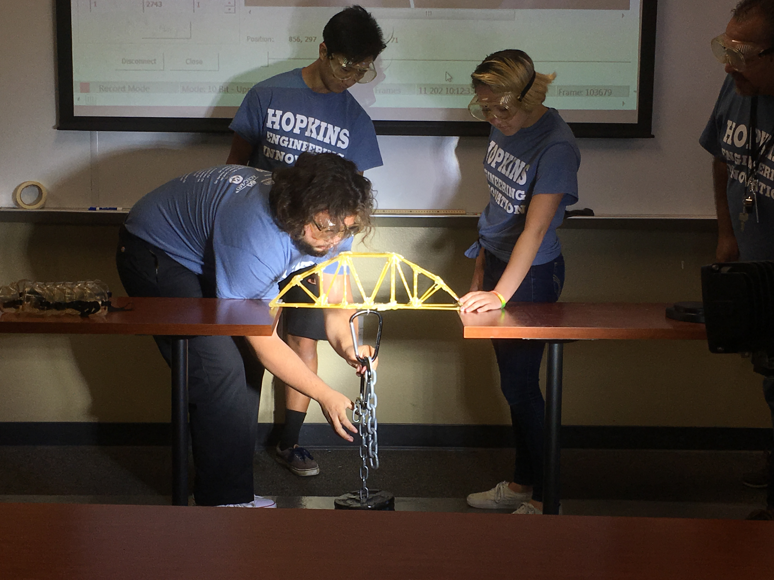
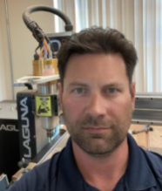
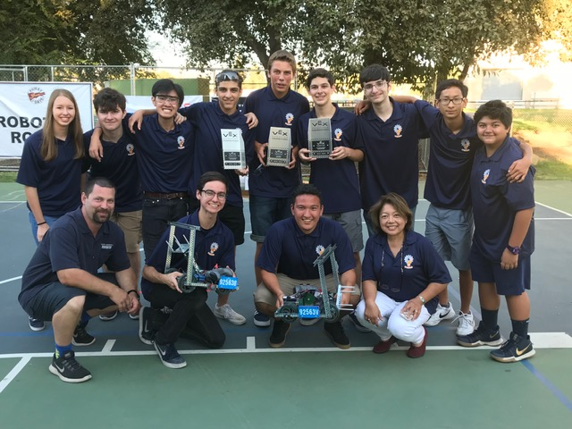
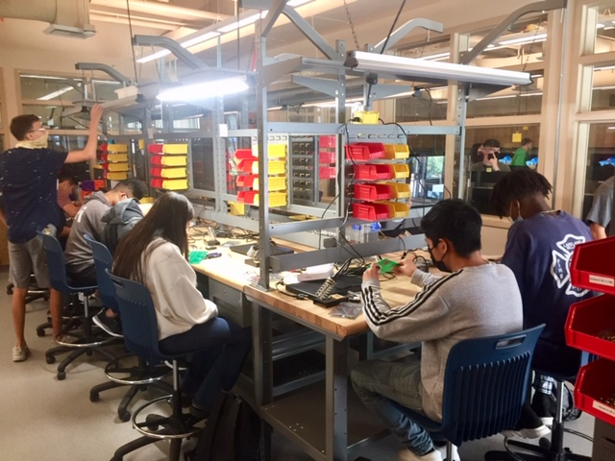
ENGINEERING
Empower students to thrive in an evolving world...
Equip yourselves with technical knowledge and skills.
ENGINEERING IS A CAREER CHOICE FOR YOU!
Inspire Change, Inspire Innovation...
PROJECT LEAD THE WAY (PLTW) Curriculum:
Activity-, Project- Problem-Based-
High-Quality Professional Development
Engaged Network/Industry Partnerships
Extra-Curricular programs:
Innovation Club/Robotics Tournaments
Design Challenge Competitions
Society of Women Engineers
Mrs. Guia Blaske
Mr. Cameron Larkins

Slide 14
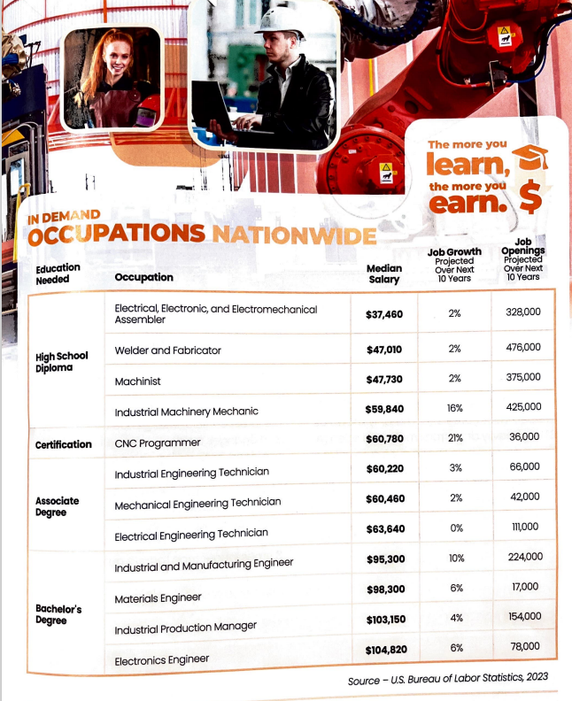
A Pathway of Choice Be a 3- or 4-course completer

Slide 15
CONTACT INFORMATION
ADVISOR(S) CONTACT INFORMATION
Mrs. Guia M. Blaske
Mr. Cameron Larkins
Engineering Teacher/CTE Chairperson
Engineering/Computer Science Teacher
www.vmhs.net
www.vmhs.net
(951) 894-5750 ex. 6628
(951) 894-5750 ex. 6632
gblaske@murrieta.k12.ca.us
clarkins@murrieta.k12.ca.us

Slide 16
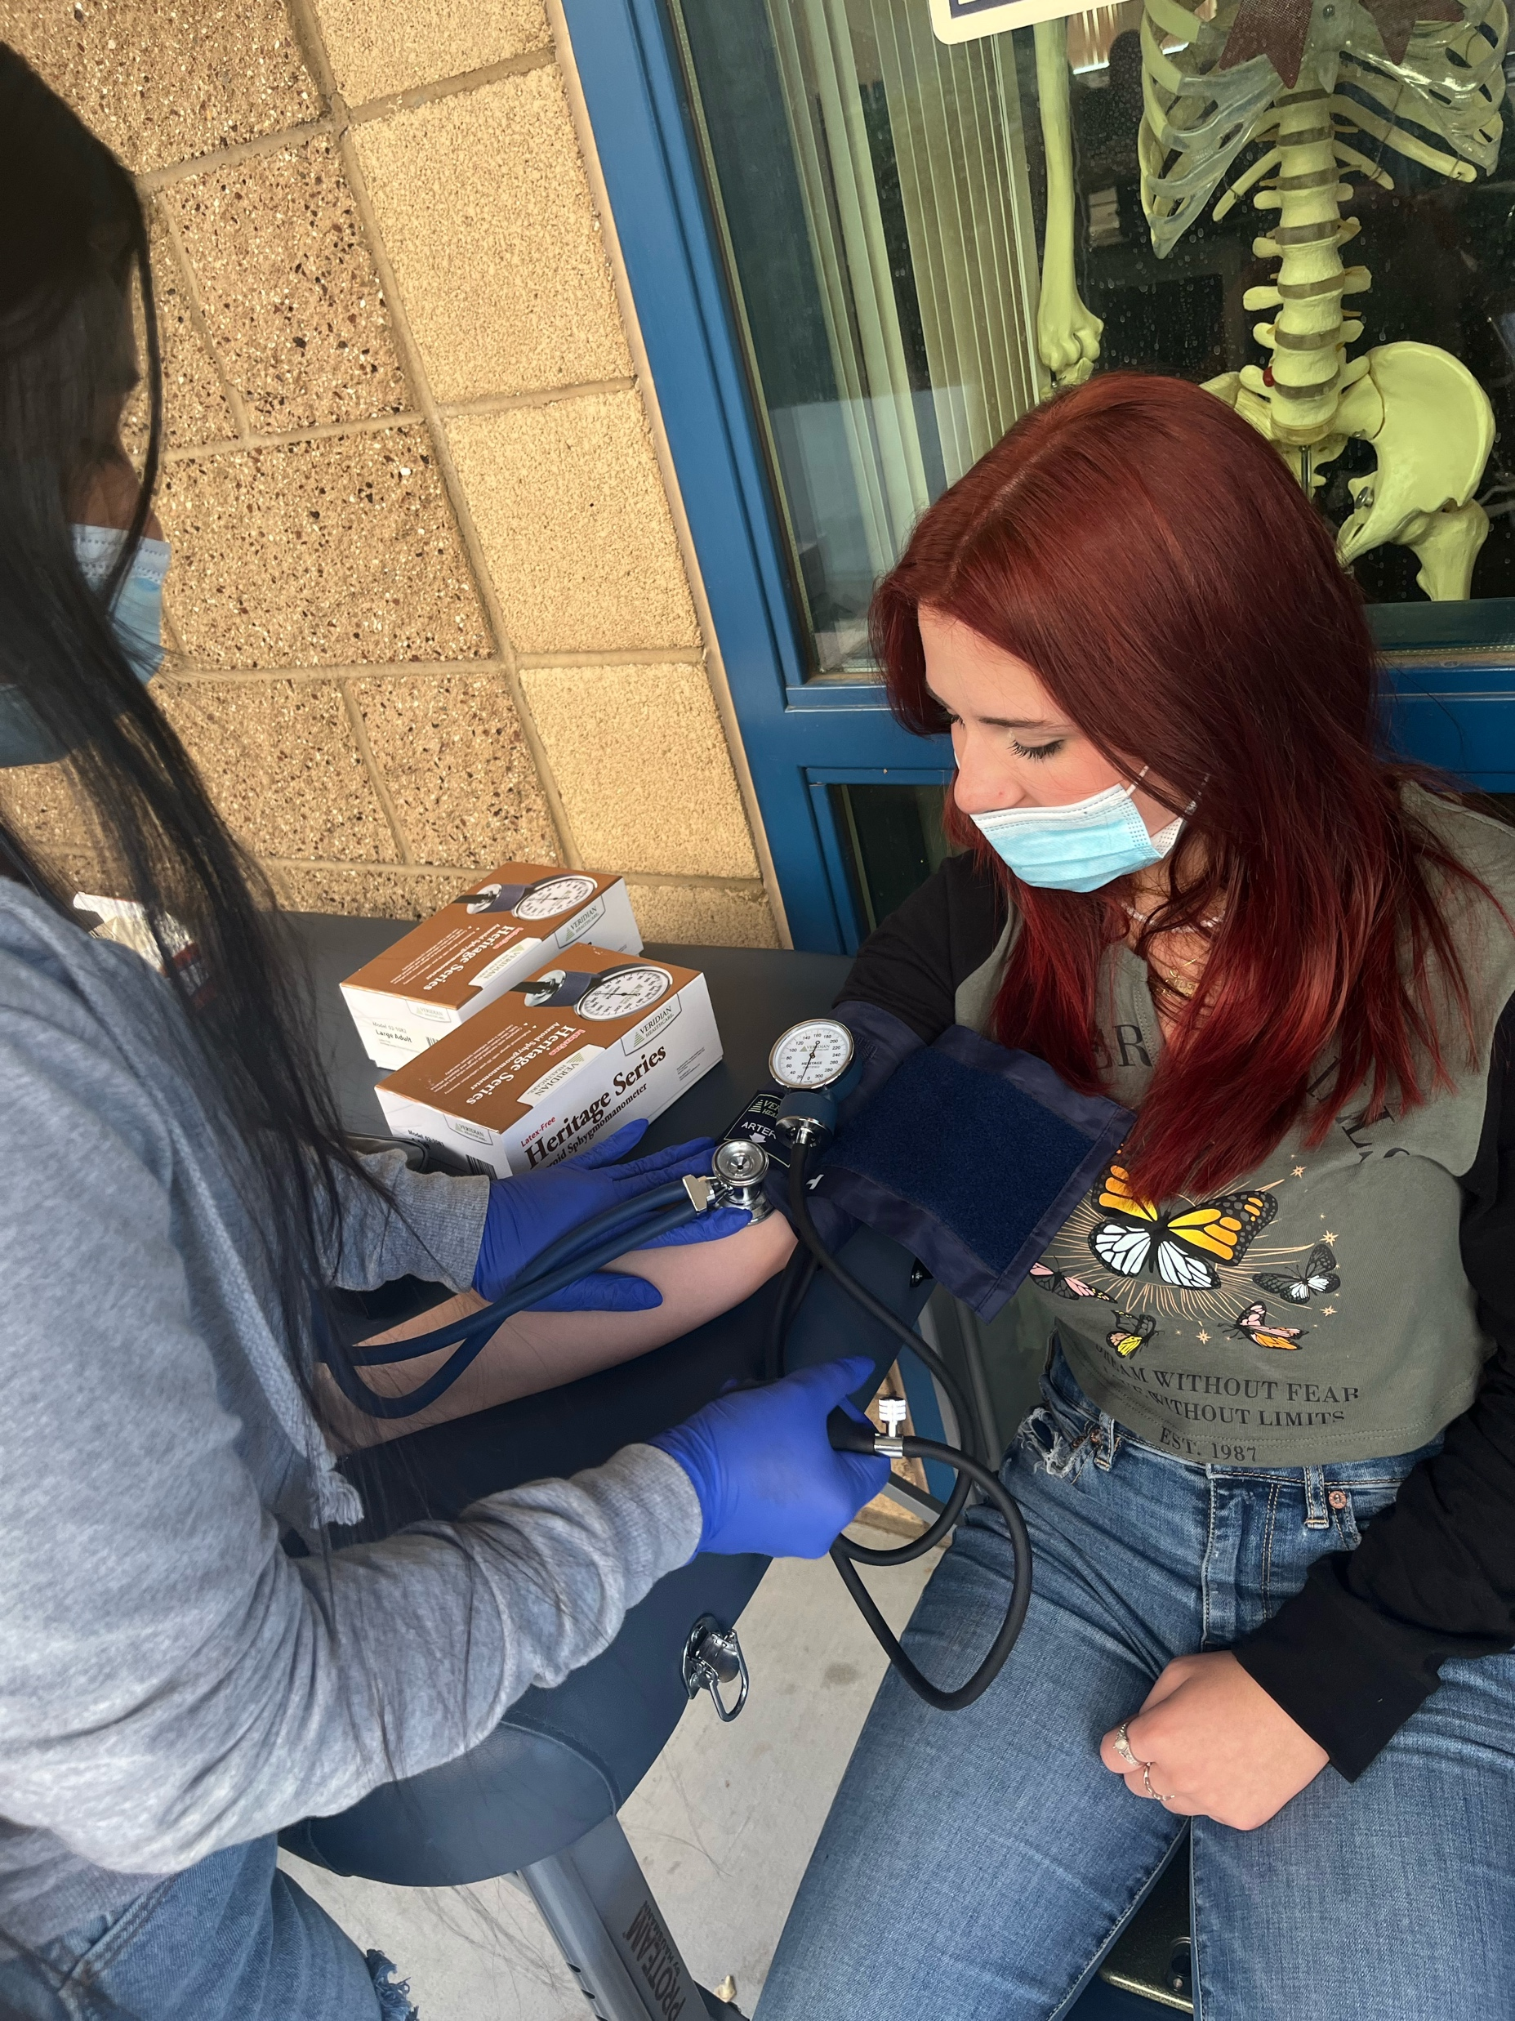
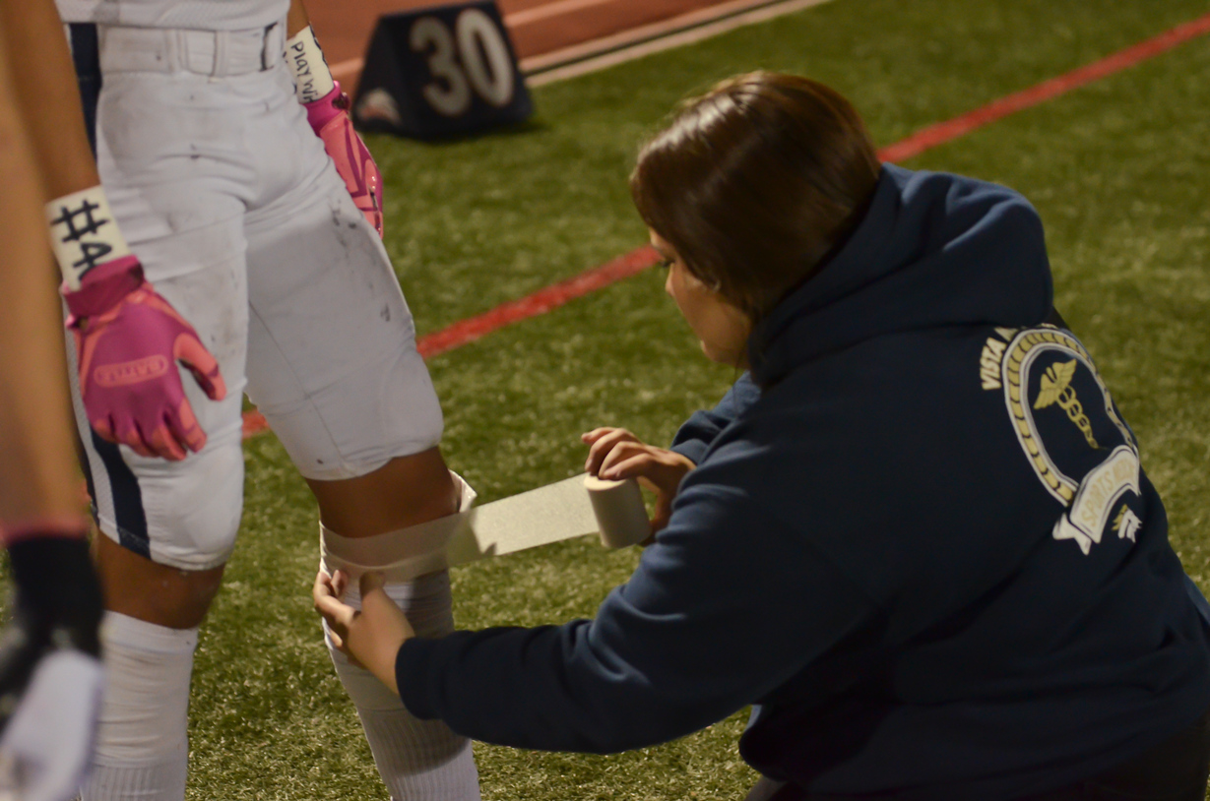
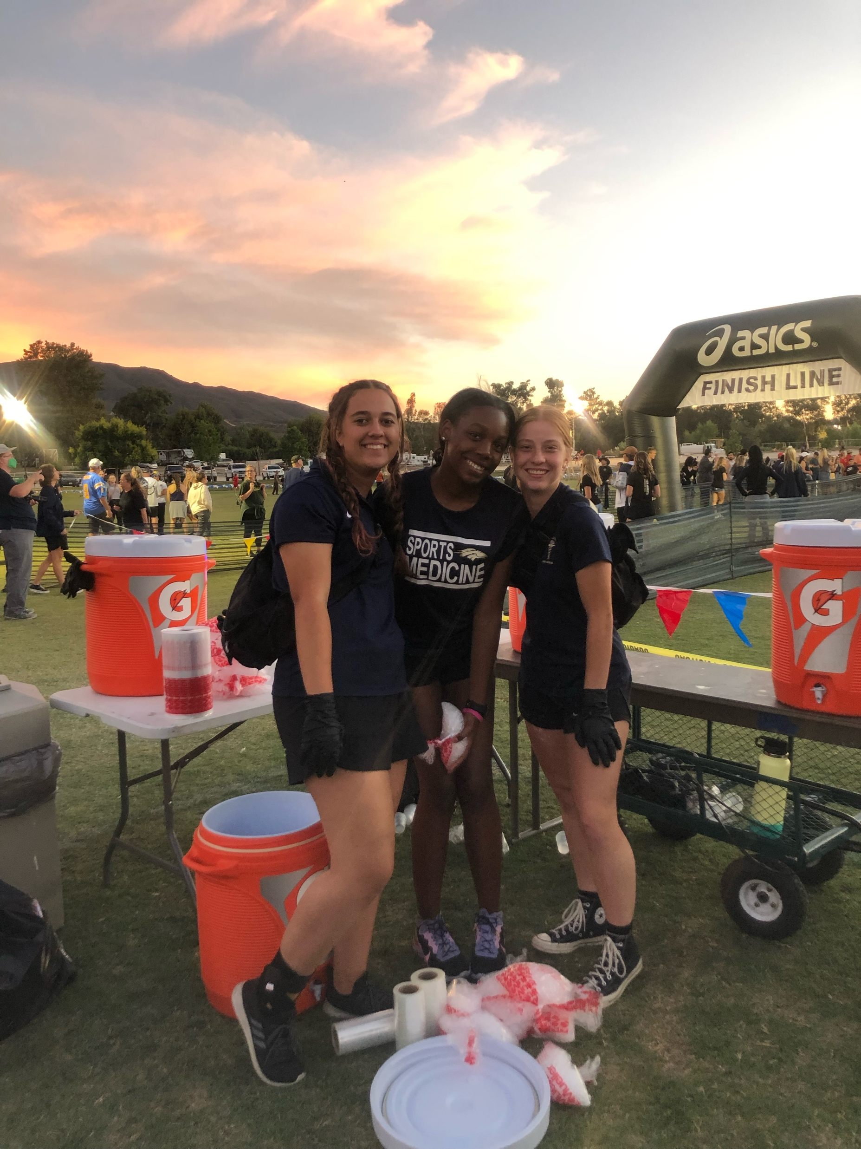
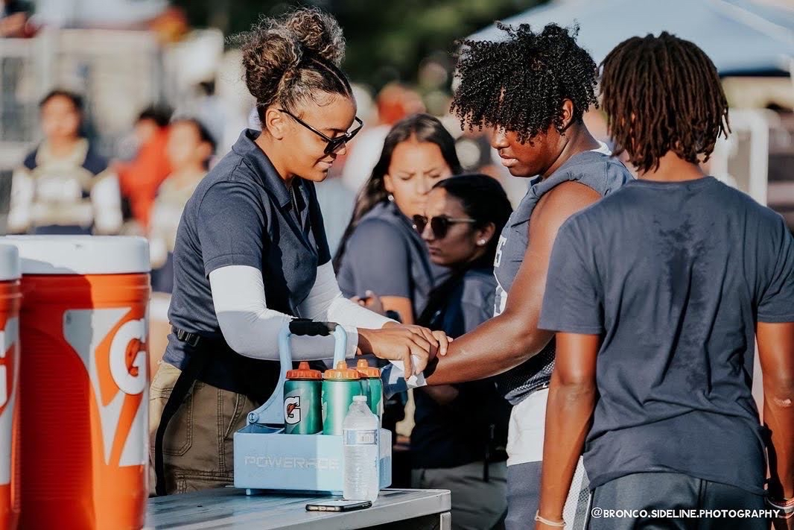
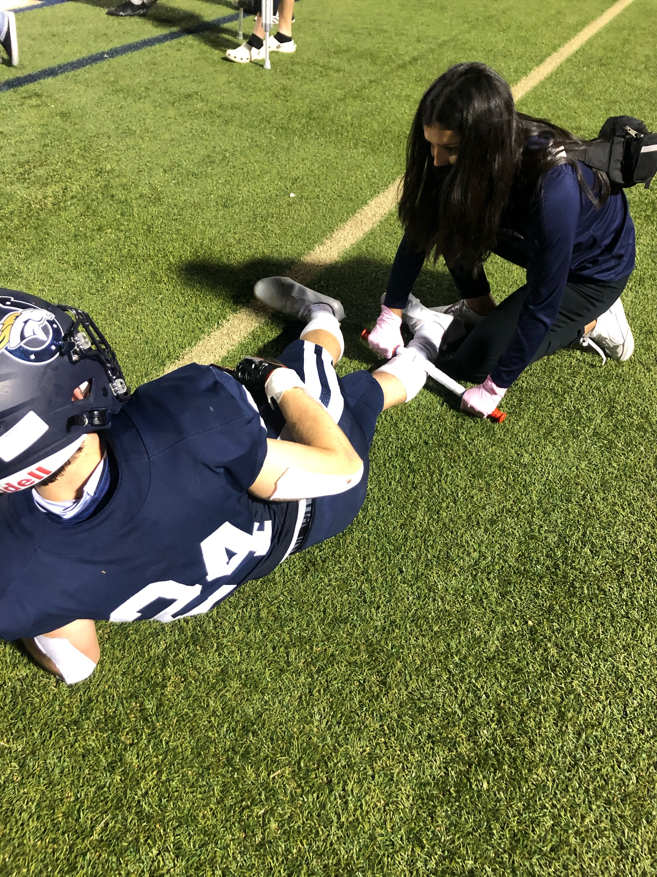
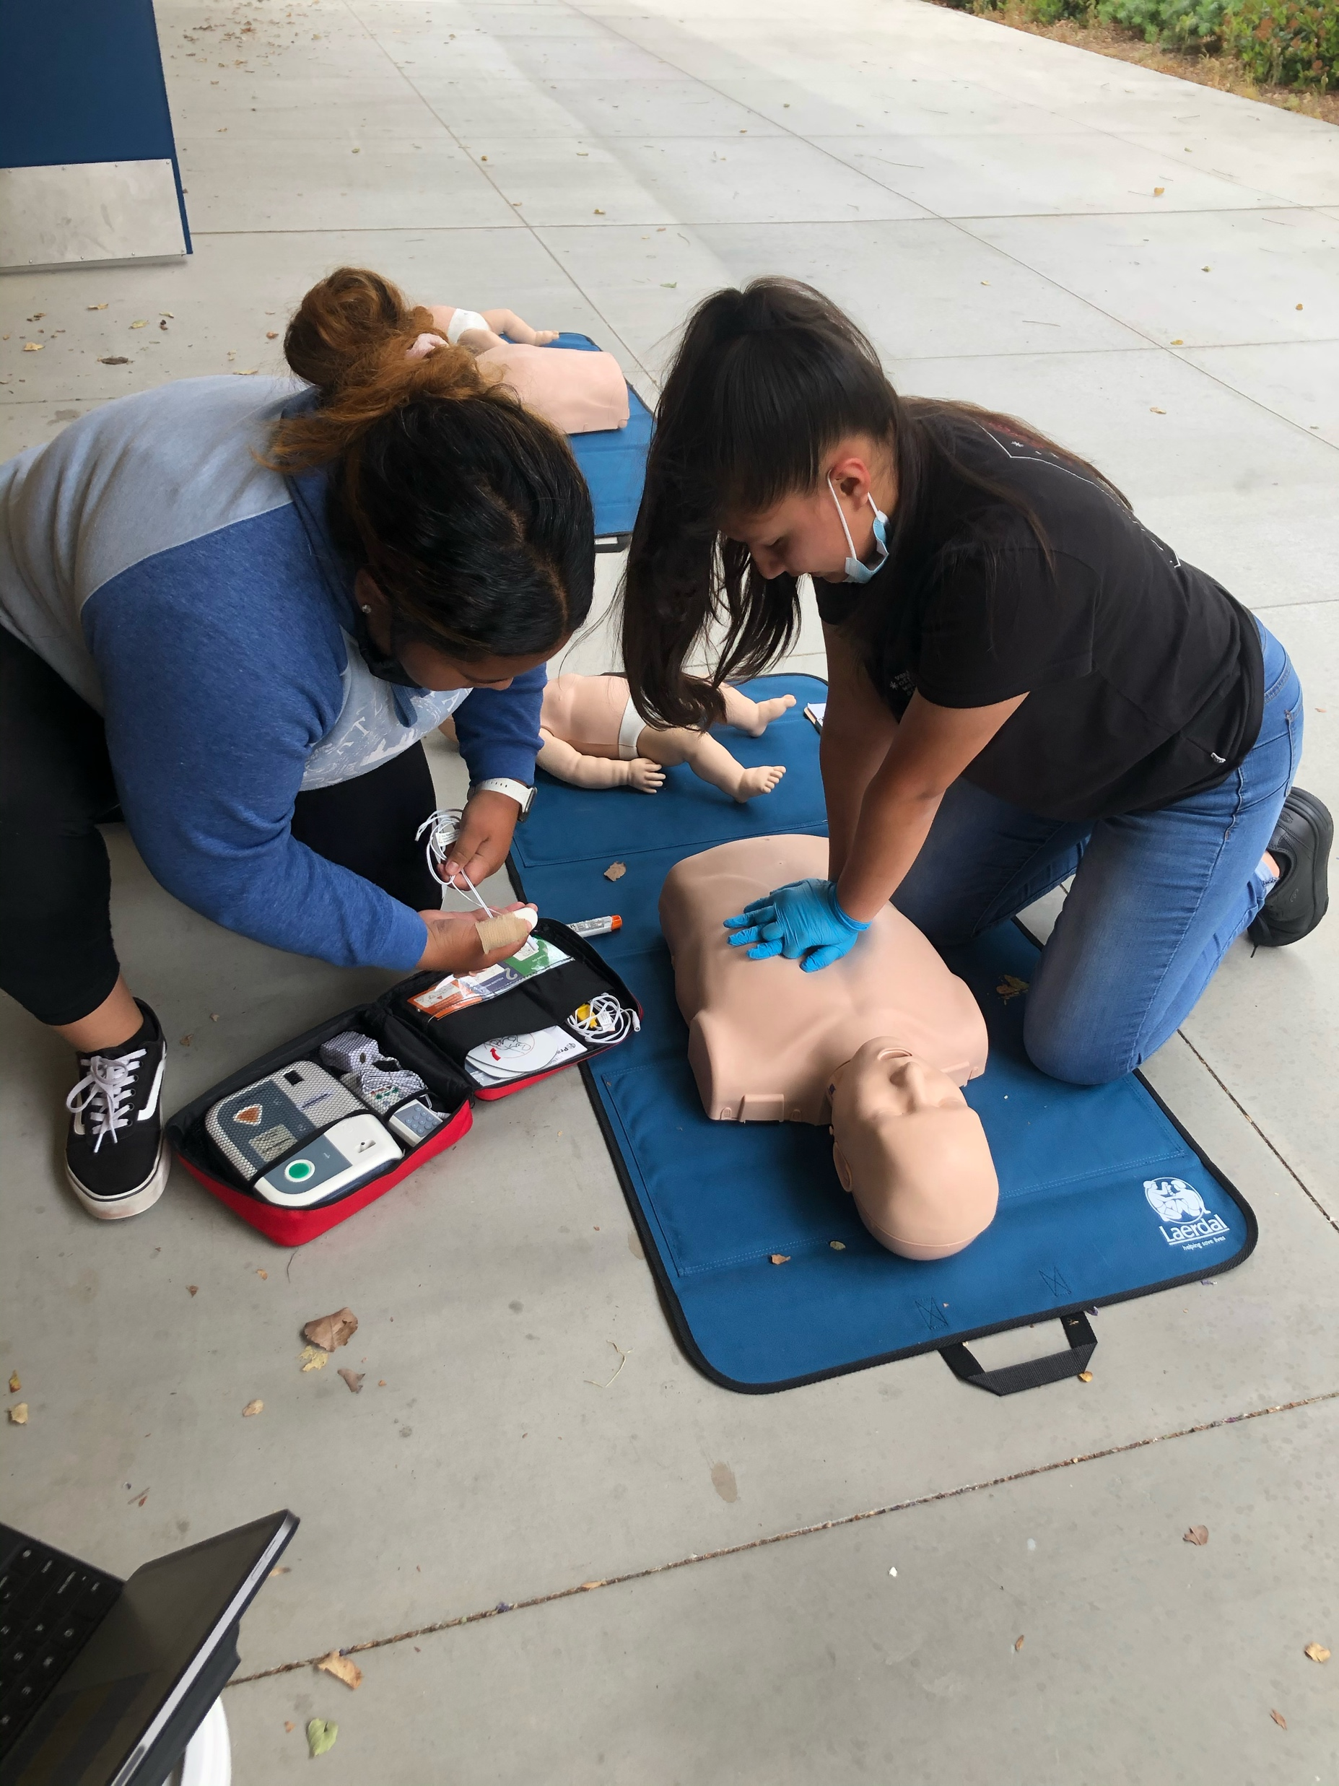
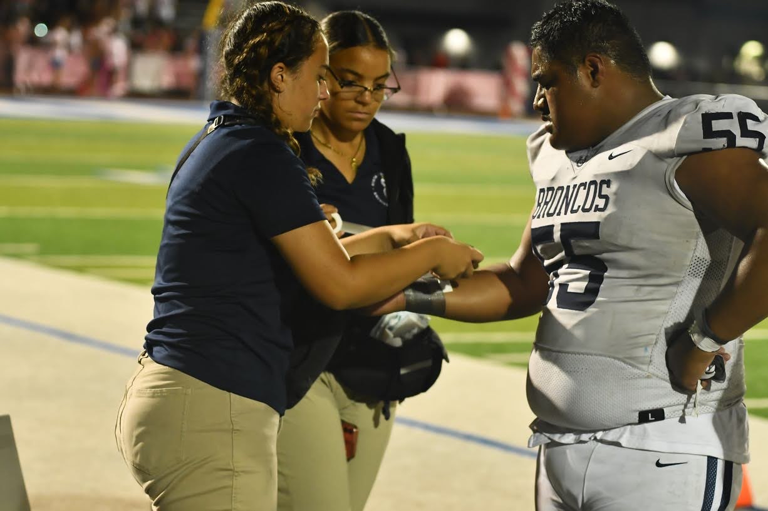
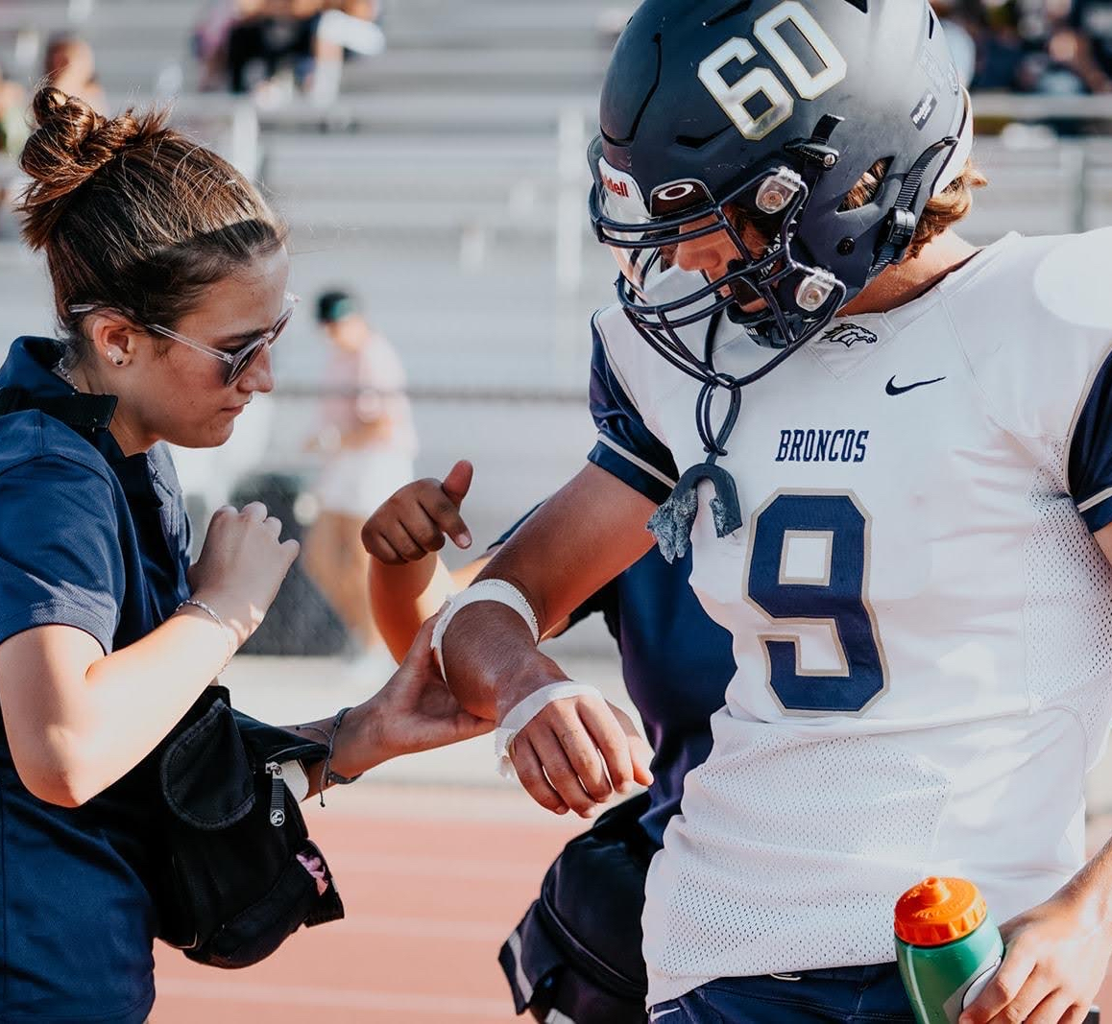
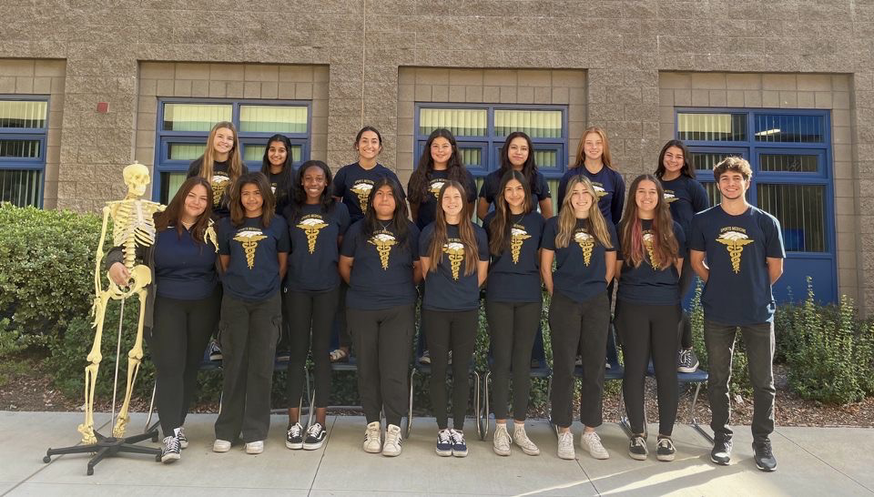
SPORTS MEDICINE
YEAR 3
Clinical Practicum
Capstone course that prepares students to participate in an internship at a healthcare related community classroom.
Redefine technical skills
Professional Development
2-3 healthcare related internship rotations
Course #7959
YEAR 1
Sports Medicine Fundamentals
Introductory course that exposes students to the healthcare field.
Vital Sign Assessment
Taping Applications
Emergency Medicine
Articulation w/ MSJC & RCC
Course #7921
YEAR 2
Kinesiology
Concentrator course allows students to practice performing an orthopedic assessment of an injured patient.
Recognition of athletic related injuries
Mock Orthopedic Patient Assessments
AHA BLS Certified
Course #7933
Extracurricular
Sports Medicine Club – Applications May 2023
Sports Medicine Competition March 2023
HOSA Conference March 2023
Jordan Taylor, MS, ATC
Certified Athletic Trainer
AHA CPR/First Aid Instructor
(951) 894-5750 ex. 6626
Jtaylor@murrieta.k12.ca.us

Slide 17
CONTACT INFORMATION
ADVISOR(S) CONTACT INFORMATION
Jordan Taylor
CTE Sports Medicine Program Advisor
www.vmhs.net
(951) 894-5750 ex. 6626
jtaylor@murrieta.k12.ca.us

Slide 18
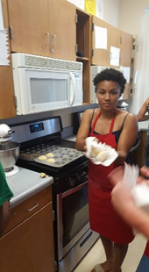
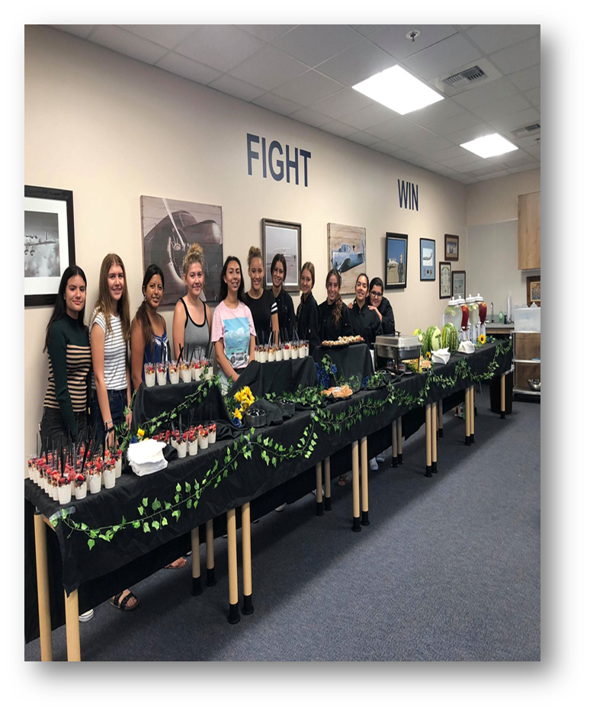
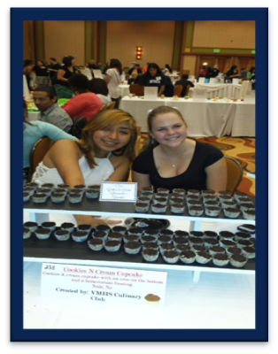
CTE HOSPITALITY, TOURISM & RECREATION SECTOR FOOD AND BEVERAGE PRODUCTION/CULINARY
Insert 3 photos - polaroid

Slide 19
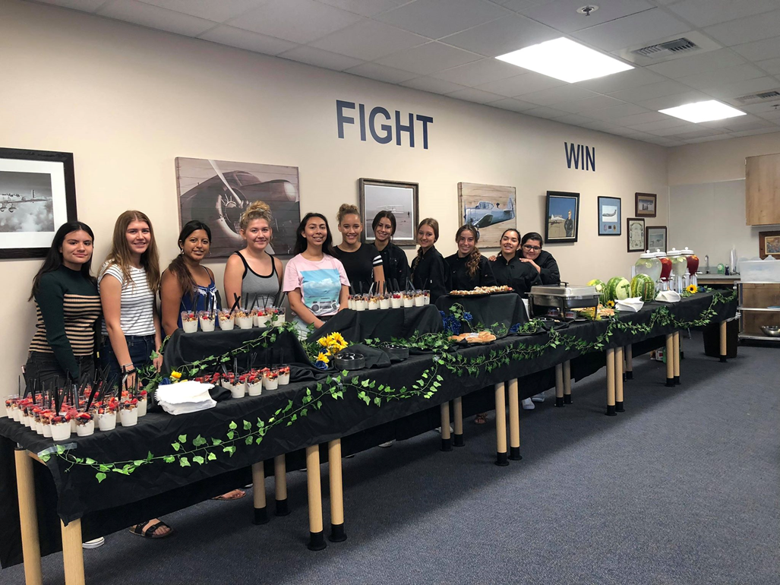
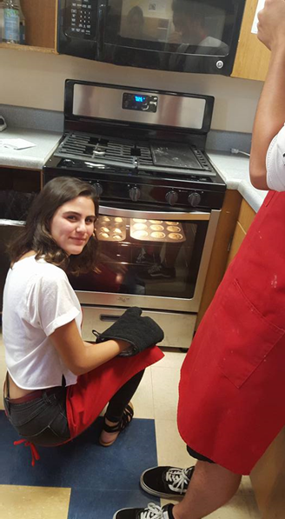
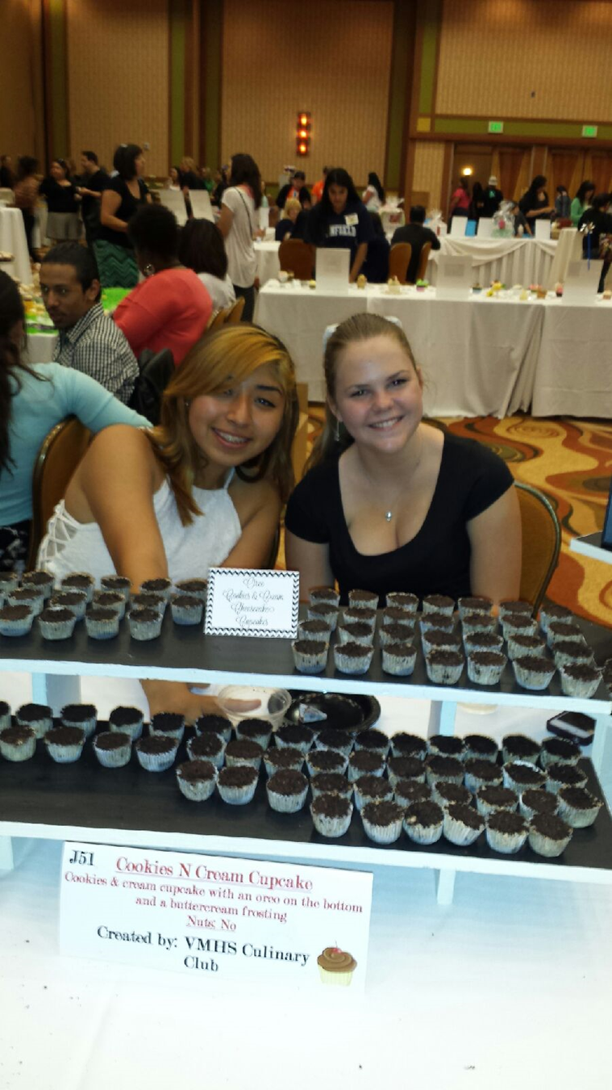
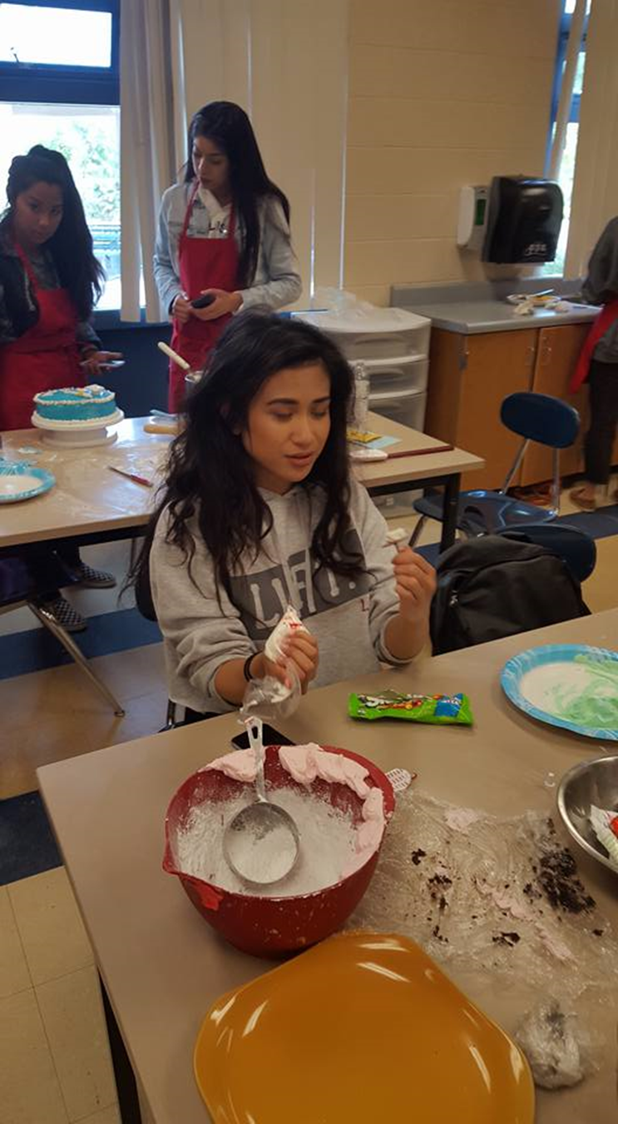
CULINARY
Come Join the fun with a hands-on class in which you can learn skills
to make the most delicious foods at home or kick start a career in Culinary.
The Culinary pathway offers 3 levels
The Culinary offers Community Service hours with Catering
The Culinary offers newfound friendships
The Culinary offers creativity
The Culinary offers a new look at food
The Culinary offers Competitive Cooking Events

Slide 20
CONTACT INFORMATION
ADVISOR(S) CONTACT INFORMATION
Joanne Wilkinson
Culinary Arts
www.vmhs.net
(951) 894-5750 ex. 6514
jwilkinson@murrieta.k12.ca.us

Slide 21
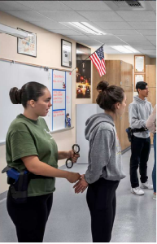
CTE PUBLIC SERVICES SECTOR CRIMINAL JUSTICE/LAW ENFORCEMENT
Insert 3 photos - polaroid
Insert 3 photos

Slide 22
CRIMINAL JUSTICE
The Criminal Justice program is a 3-year CTE pathway.
Classes are G certified. Open to 10th-12th graders.
Articulated with MSJC for college credit.
There is also a CJ club, which meets every other week!
The program will help you better understand the CJ system.
There are guest speakers, field trips, and hands on lab activities.
The program will open your eyes to over 100 opportunities in the CJ career field.

Slide 23
CONTACT INFORMATION
ADVISOR(S) CONTACT INFORMATION
Robert Ritchie
CTE Criminal Justice Program Advisor
www.vmhs.net
(951) 894-5750 ex. 6623
rritchie@murrieta.k12.ca.us

Slide 24
CTE EDUCATION, CHILD DEVELOPMENT & FAMILY SERVICES SECTOR EDUCATION
Insert 3 photos - polaroid

Slide 25
New Pathway: EDUCATION
Course 1: Foundations in Education
Teacher: Nicole Cheslar
School year 2023-2024
*Concentrator and Capstone classes will be added in the future!

Slide 26
CONTACT INFORMATION
ADVISOR(S) CONTACT INFORMATION
Nicole Cheslar
CTE Education Teacher/Advisor
www.vmhs.net
(951) 894-5750 ext. 6725
ncheslar@murrieta.k12.ca.us

Slide 27
Career Readiness >> Pathway Choice
Prepare for your future by exploring careers and acquire job specific skills through:
✔ Technical Training
✔ Hands-on learning and participation in
✔ Work-based learning activities while obtaining
✔ Advanced technical training
✔ You can receive college credit while in high school

Slide 28
Career Readiness >> Pathway Choice
ALL PROGRAMS OF STUDY WILL OFFER A COMPLETE 2-3 COURSE SEQUENCE PROVIDING AN:
Introductory Course
Concentrator Course
Capstone Course
See your course catalog for specific program descriptions and prerequisites or see your counselor or CTE Teacher/Staff for additional information.

Slide 29
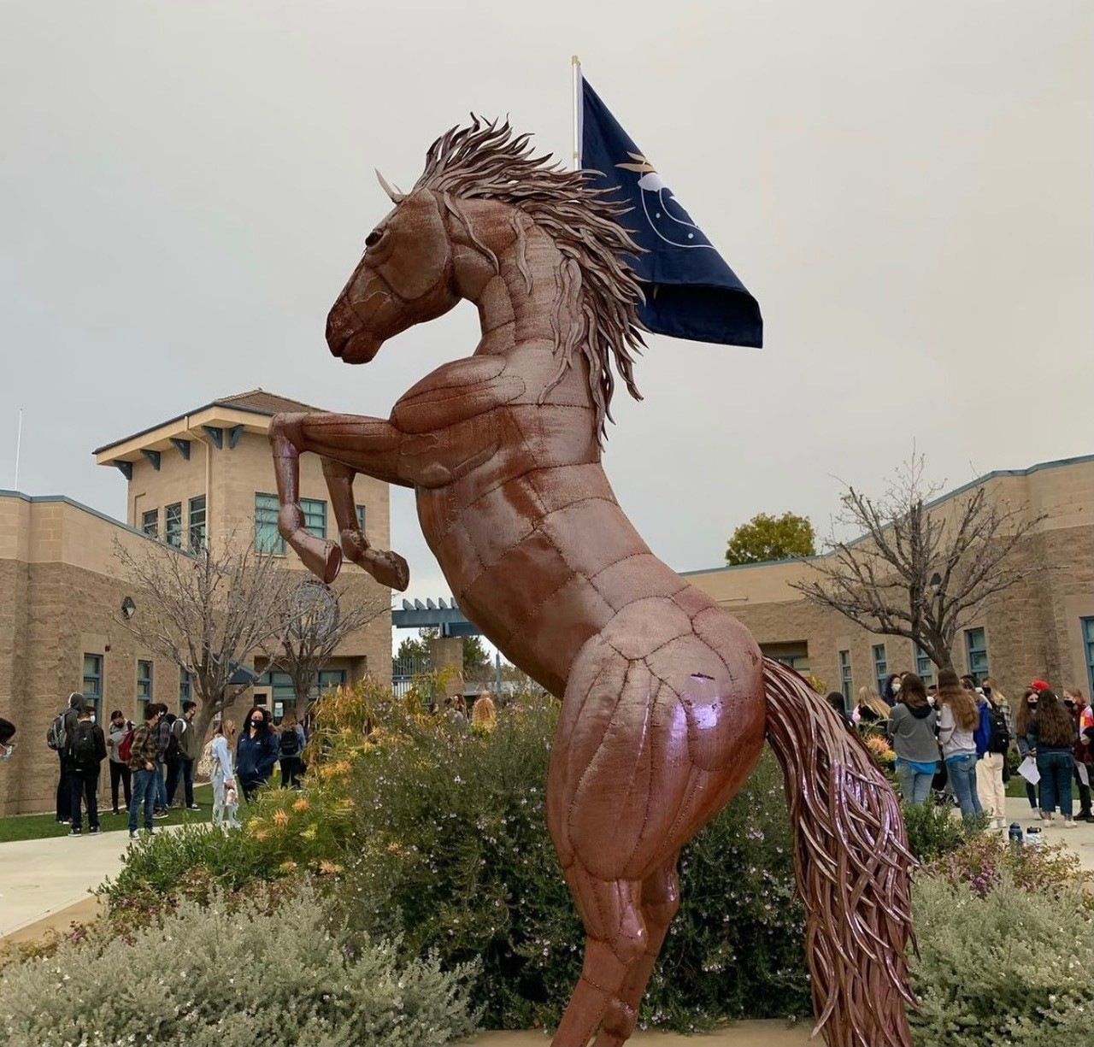
GO BRONCOS!
Presented by:
Mrs. Guia M. Blaske
CTE-Engineering Teacher
CTE-ICT Department Chairman
VISTA MURRIETA HIGH SCHOOL
January 30, 2024
Character Leadership Attitude Scholarship Service

